Slide 1
Introduction
Lei Wu
Zhejiang University

Slide 2
Disclaimer
Many images and resources used in this lecture are collected from the Internet, and they are used only for the educational purpose. The copyright belong to the original owners, respectively.
Part of slides credit to
CS 3410: Computer System Organization and Programming (Prof. Weatherspoon, Prof. Bala, Prof. Bracy, and Prof. Sirer @ Cornell)
Henri Casanova @ Hawaii
Yajin Zhou, Wenbo Shen @ ZJU

Slide 3
Instructor & TA
Instructors
沈浩頲 Haoting Shen (htshen@zju.edu.cn)
卢立 Li Lu (li.lu@zju.edu.cn)
冯博 Bo Feng (bo.feng@zju.edu.cn)
吴磊 Lei Wu (lei_wu@zju.edu.cn)
常瑞 Rui Chang (crix1021@zju.edu.cn)
TAs
史璐欣
洪奕迅

Slide 4
Today’s Agenda
Why take computer system courses?
About system courses
Course overview
Evolution of computer systems

Slide 5
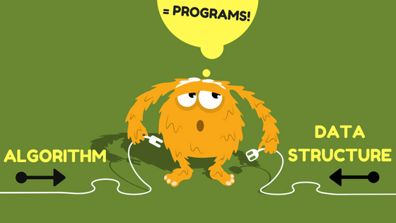
What is a Computer Program?

Slide 6
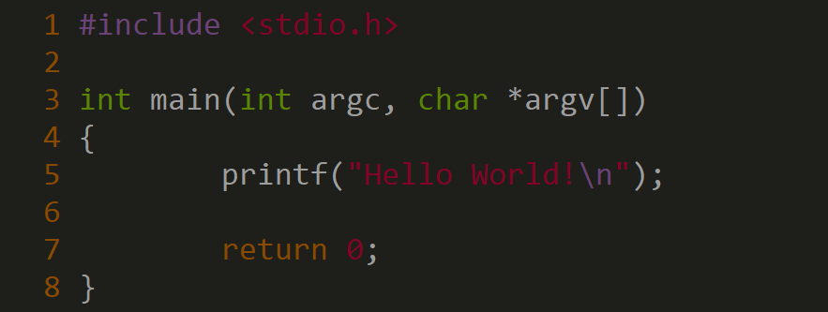
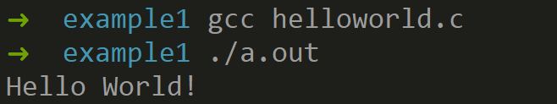
Reflect the first Hello World!
About a.out
Let’s take a look!

Slide 7

Reflect the first Hello World!
How does it work?
Why we need to compile the program?
What is in an executable file?
How to execute a program?
What is Operating System (OS)? What does OS do?
How does the underlying hardware support the software?

Slide 8
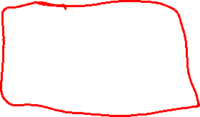
Source Code -> Executable File
C
int x = 10;
x = 2 * x + 15;
compiler
r0 = 0
r5 = r0 + 10
r5 = r5 * 2
r5 = r5 + 15
RISC-V
assembly
language
addi r5, r0, 10
muli r5, r5, 2
addi r5, r5, 15
Everything is a number!
assembler
10 r0 r5 op = addi
RISC-V
machine
language
00000000101000000000001010010011
00000000000100101001001010010011
00000000111100101000001010010011
15 r5 r5 op = addi

Slide 9
How to Execute Instructions?

Slide 10
Basic Computer System
A processor executes instructions
Processor has some internal state in storage elements (registers)
A memory holds instructions and data
von Neumann architecture: combined inst and data
A bus connects the two

Slide 11
Von-Neumann
In 1944, John von Neumann joined ENIAC
He wrote a memo about computer architecture, formalizing ENIAC ideas
Eckert and Mauchly have pretty much been forgotten (they were in the trenches)
These ideas became the Von Neumann architecture model
A processor that performs operations and controls all that happens
A memory that contains code and data
I/O of some kind

Slide 12
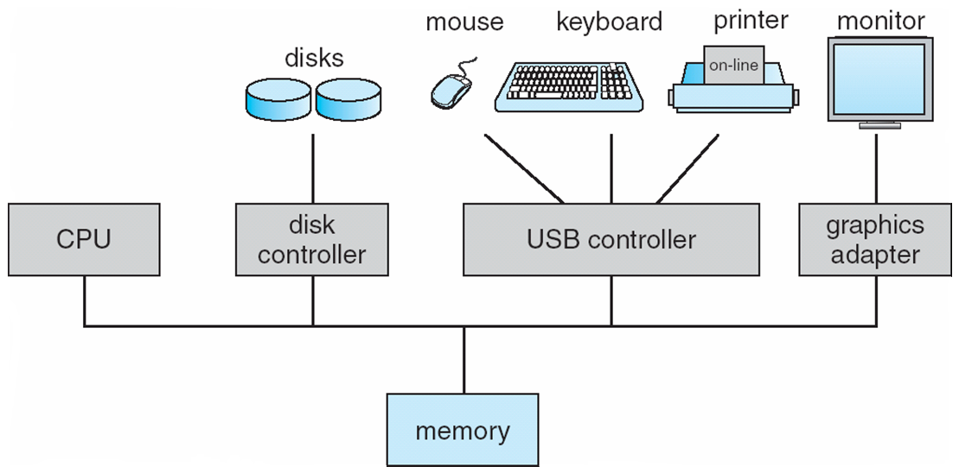
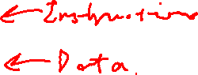
Von-Neumann Model
CPU
Memory
I/O
System
Amazingly, it’s still possible to think of the computer this way at a conceptual level (model from ~80 years ago!!!)
A computer today has
some differences

Slide 13
Data Stored in Memory
All “information” in the computer is in binary form
Since Claude Shannon’s M.S. thesis in the 30’s
0: zero voltage, 1: positive voltage (e.g., 5V)
bit: the smallest unit of information (0 or 1)
The basic unit of memory is a byte
1 Byte = 8 bits, e.g., “0101 1101”
Each byte in memory is labeled by a unique address
All addresses in the machine have the same number of bits
e.g., 64-bit addresses on ARM64
The processor has instructions that say “Read the byte at address X and give me its value” and “Write some value into the byte at address X”

Slide 14

Conceptual View of Memory
address | content
0000 0000 0000 0000 | 0110 1110
0000 0000 0000 0001 | 1111 0100
0000 0000 0000 0010 | 0000 0000
0000 0000 0000 0011 | 0000 0000
0000 0000 0000 0100 | 0101 1110
0000 0000 0000 0101 | 1010 1101
0000 0000 0000 0110 | 0000 0001
0000 0000 0000 0111 | 0100 0000
0000 0000 0000 1000 | 1111 0101
... | ...

Slide 15

Conceptual View of Memory
address | content
0000 0000 0000 0000 | 0110 1110
0000 0000 0000 0001 | 1111 0100
0000 0000 0000 0010 | 0000 0000
0000 0000 0000 0011 | 0000 0000
0000 0000 0000 0100 | 0101 1110
0000 0000 0000 0101 | 1010 1101
0000 0000 0000 0110 | 0000 0001
0000 0000 0000 0111 | 0100 0000
0000 0000 0000 1000 | 1111 0101
... | ...
At address 0000 0000 0000 0010
the content is 0000 0000

Slide 16
Conceptual View of Memory
address | content
0000 0000 0000 0000 | 0110 1110
0000 0000 0000 0001 | 1111 0100
0000 0000 0000 0010 | 0000 0000
0000 0000 0000 0011 | 0000 0000
0000 0000 0000 0100 | 0101 1110
0000 0000 0000 0101 | 1010 1101
0000 0000 0000 0110 | 0000 0001
0000 0000 0000 0111 | 0100 0000
0000 0000 0000 1000 | 1111 0101
... | ...
At address 0000 0000 0000 0100
the content is 0101 1110

Slide 17
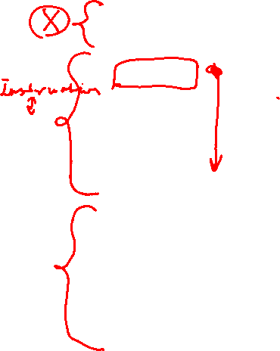
Both Code and Data in Memory
Once a program is loaded in memory, its address space contains both code and data
To the CPU those are not really different, but the programmer knows which bytes are data and which are code
Always conveniently hidden from you if you’ve never written assembly
But we’ll have to keep code/data straight in these lecture notes
Example Address Space
Address
Value
0000 1100
0010 1101
Code
0000 1101
1111 0010
0000 1110
0010 0001
...
...
1000 0000
1111 0000
...
...
Data
1111 0010
0101 1111
Memory

Slide 18
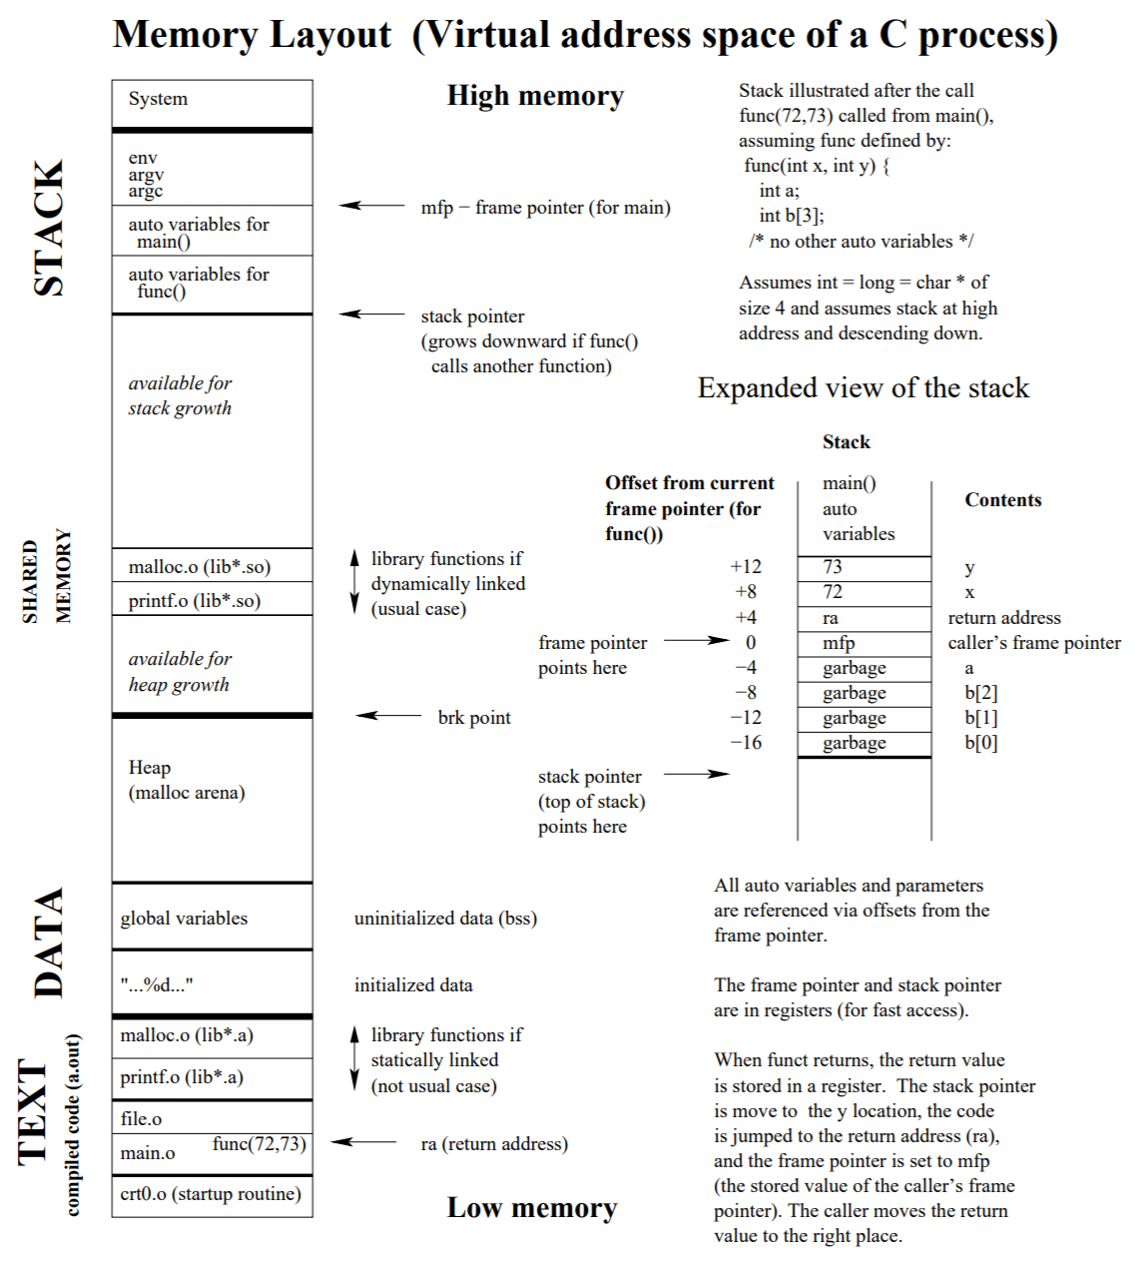
Memory Layout

Slide 19
We need a CPU
So now we have a memory in which we can store/retrieve bytes at precise location
These bytes presumably have some useful meaning to us
e.g., integers, ASCII codes of characters, floating points numbers, RGB values
e.g., instructions that specify what to do with the data; when you buy a processor, the vendor defines the instruction set (e.g., instruction “0010 1101” means “increment some useful counter”)
The CPU is the piece of hardware that modifies the content of memory
In fact, one can really think of the CPU as a device that moves one memory state (i.e., all the stored content) to another memory state (some new, desired stored content)

Slide 20
What’s in the CPU?
CPU
Memory
I/O
System

Slide 21
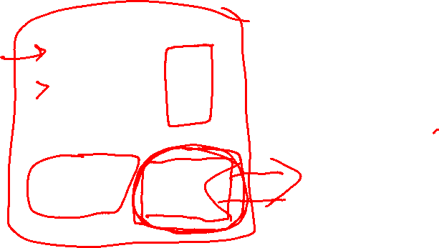
What’s in the CPU?
Program counter
register
current instruction
register
register
Memory
ALU
Control
Unit
I/O
System

Slide 22
What’s in the CPU?
Program counter
register
current instruction
register
register
Registers: the “variables” that hardware instructions work with
Data can be loaded from memory into a register
Data can be stored from a register back into memory
Operands and results of computations are in registers
Accessing a register is really fast
There is a limited number of registers
ALU
Control
Unit

Slide 23
What’s in the CPU?
Program counter
register
current instruction
register
register
ALU
Control
Unit
Arithmetic and Logic Unit: what you do computation with
Used to compute a value based on current register values and
store the result back into a register
+, *, /, -, OR, AND, XOR, etc.

Slide 24
What’s in the CPU?
Program counter
register
Program Counter: Points to the next instruction
Special register that contains the address in memory of the next instruction that should be executed
(gets incremented after each instruction, or can be set to whatever value whenever there is a change of control flow)
current instruction
register
register
ALU
Control
Unit

Slide 25
What’s in the CPU?
Program counter
register
current instruction
register
register
Current Instruction: Holds the instruction that’s currently being executed
ALU
Control
Unit

Slide 26
What’s in the CPU?
Program counter
register
current instruction
register
register
ALU
Control
Unit
Control Unit: Decodes instructions and make them happen
Logic hardware that decodes instructions (i.e., based on their bits) and sends the appropriate (electrical) signals to hardware components in the CPU

Slide 27
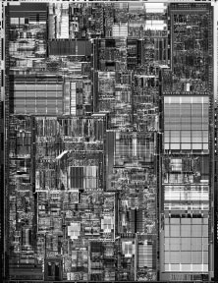
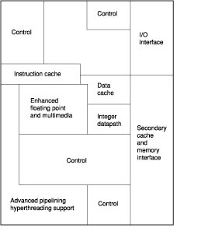
The CPU in its “Glory”

Slide 28
Why Take System Courses?
Basic knowledge needed for many other areas of CS
Compiler
Parallel Computing
New era of AI/ML
Understand where the world is going
Delve into the underlying implementation
Address bug or performance issues
Become more effective programmers
The Mysteries of Computing will be revealed!

Slide 29
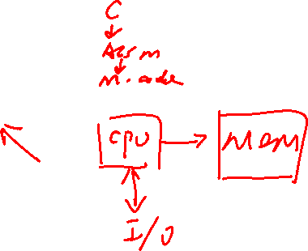
Today’s Agenda
Why take system courses?
About system courses
Course overview
Evolution of computer systems

Slide 30
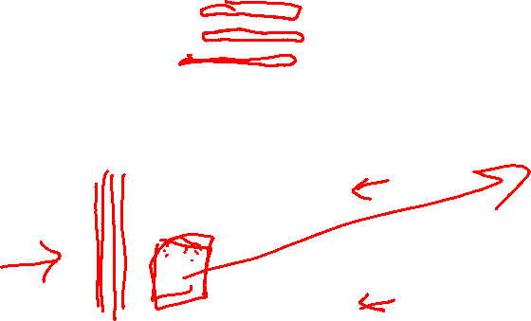
A Look into AMD CPU

Slide 31
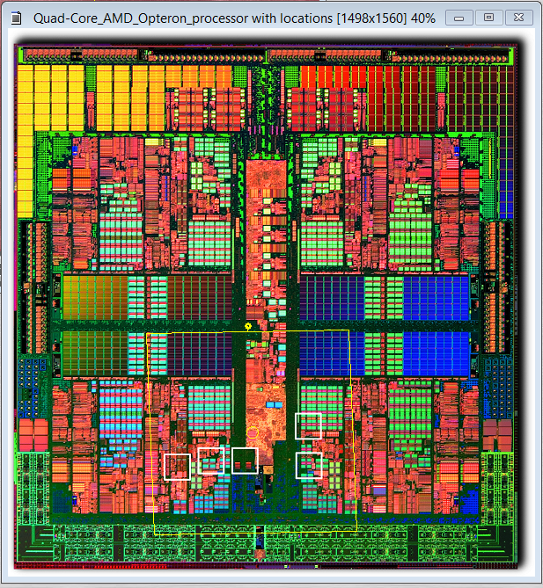
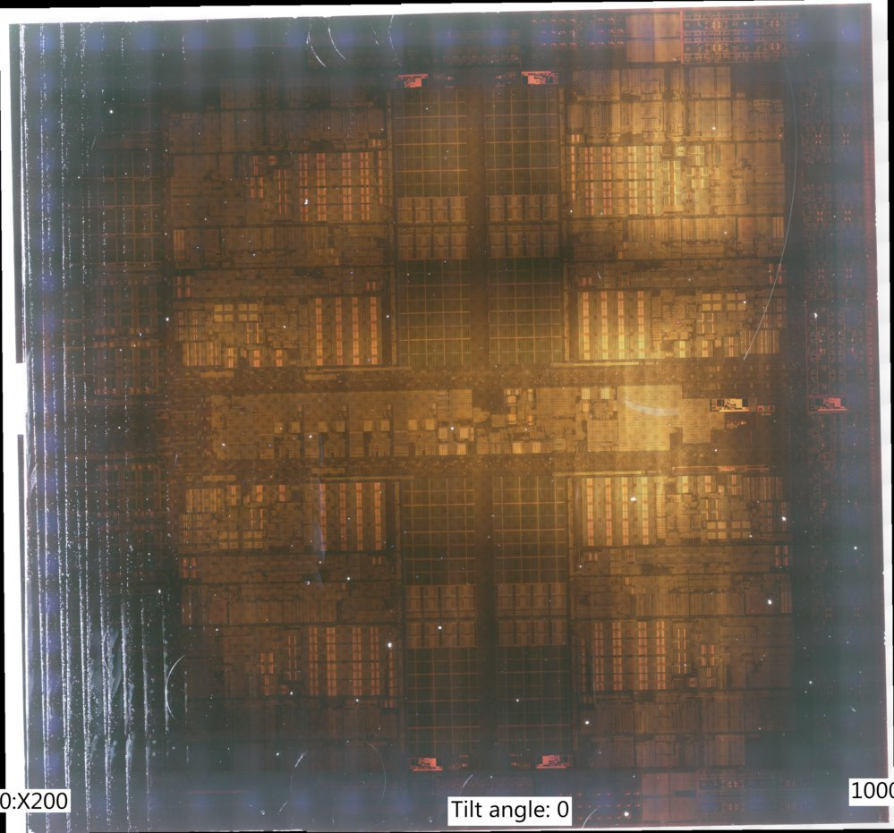
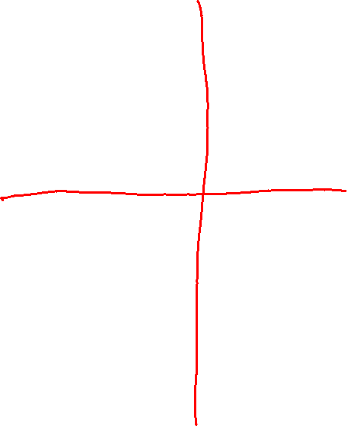

Slide 32
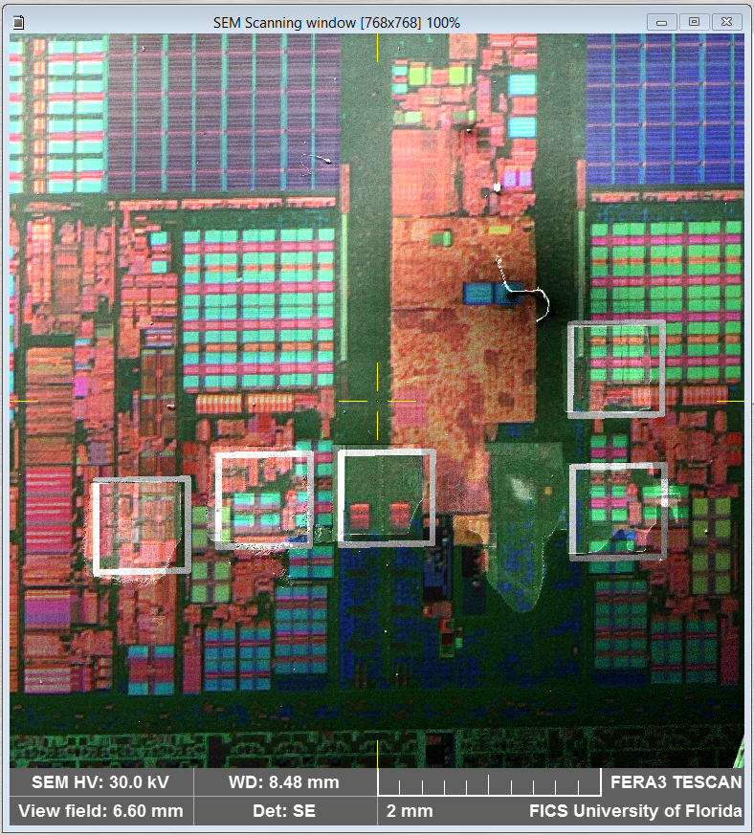
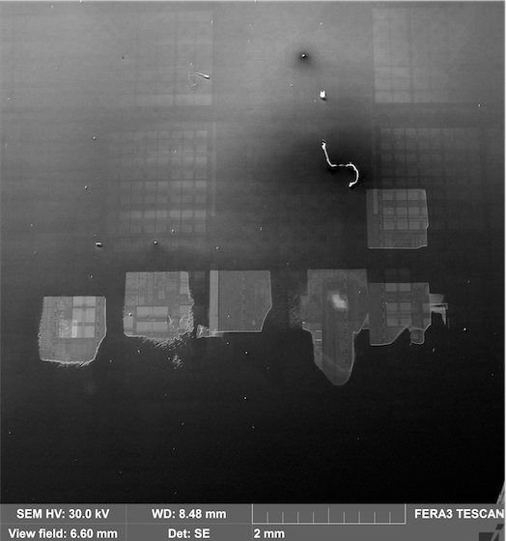

Slide 33
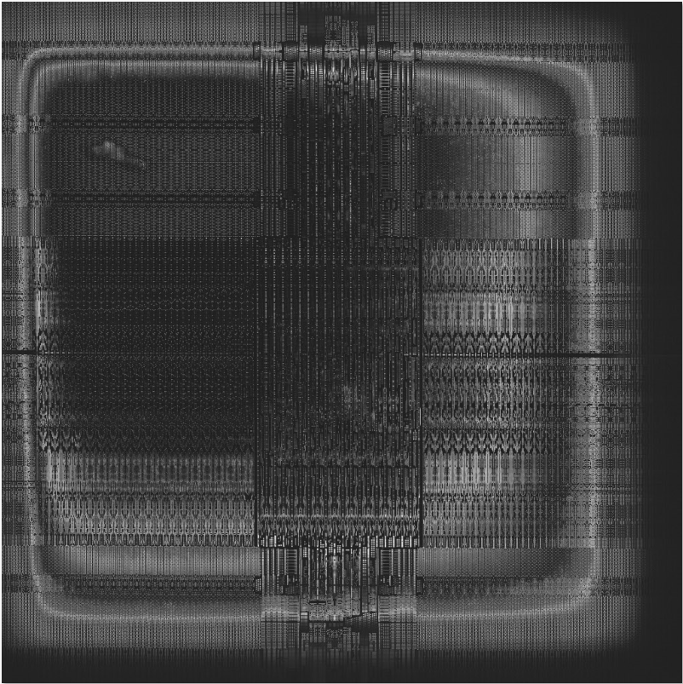



Slide 34
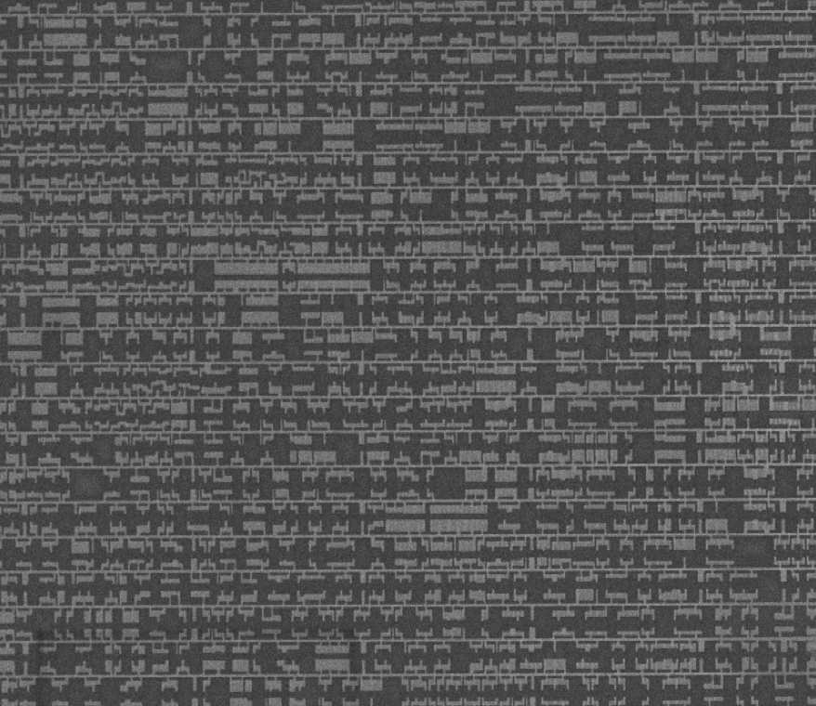
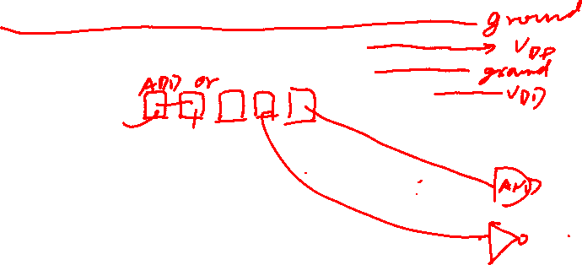
A Look into AMD CPU

Slide 35
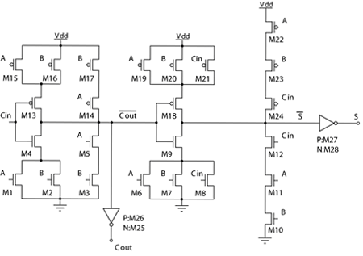
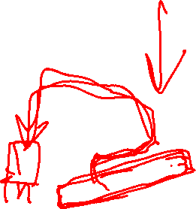
Transistor Schematic
Full adder
Very Large Scale Integrated (VLSI) Circuit

Slide 36
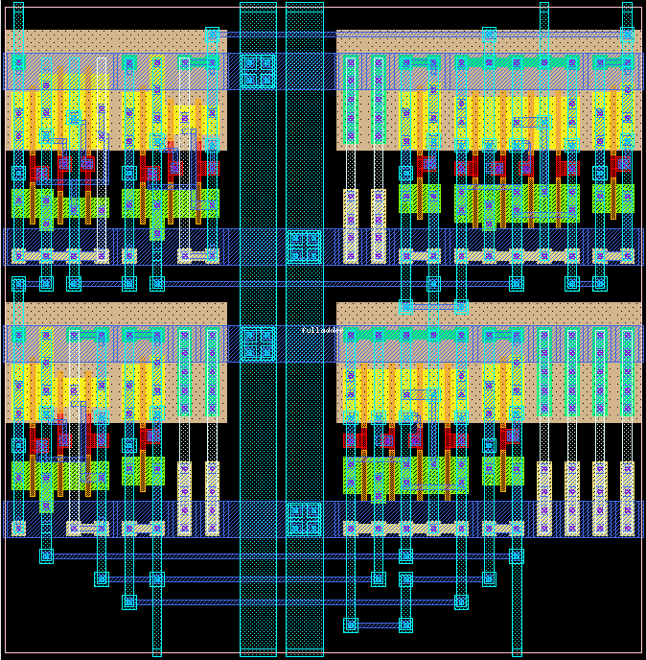
Layout

Slide 37
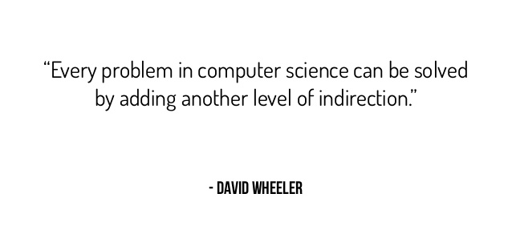
Layer of Abstraction

Slide 38
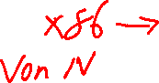
Abstract Layers of A COMPUTER SYSTEM
Application
Compiler / Libraries of Macros and Procedures
Software
Operating System
Operating System (OS)
Computer Architecture
Instruction Set Architecture (ISA)
Computer Organization
Computer Organization (Micro Architecture)
Digital Logic
Register Transfer Level (RTL)
Hardware
Digital Logic Circuit (DLC)
Device Technology

Slide 39
Covered in ZJU Computer System Courses
Application
Compiler / Libraries of Macros and Procedures
Software
Operating System (OS)
System-II&III
Instruction Set Architecture (ISA)
Computer Organization (Micro Architecture)
System-I
Register Transfer Level (RTL)
Hardware
Digital Logic Circuit (DLC)
Device Technology

Slide 40
ZJU Computer System Courses - since 2021
System I
System II
System III
Operating System
Computer Organization
Computer Architecture
Digital Logic
Notes:
Add security

Slide 41
ZJU Computer System Courses - since 2021

Slide 42
ZJU Computer System Courses - since 2021

Slide 43
ZJU Computer System Courses - since 2021

Slide 44
Experiments for Computer System

Slide 45
Experiments for Computer System

Slide 46
Experiments for Computer System

Slide 47
ZJU Computer System Courses
System Security
YOUR ADVANCED KERNEL based on YOUR OWN CPU!
System I
System II
System III
YOUR FIRST KERNEL based on YOUR OWN CPU!
YOUR OWN CPU!
Operating System
Computer Organization
Computer Architecture
Digital Logic
47
Notes:
Add security

Slide 48
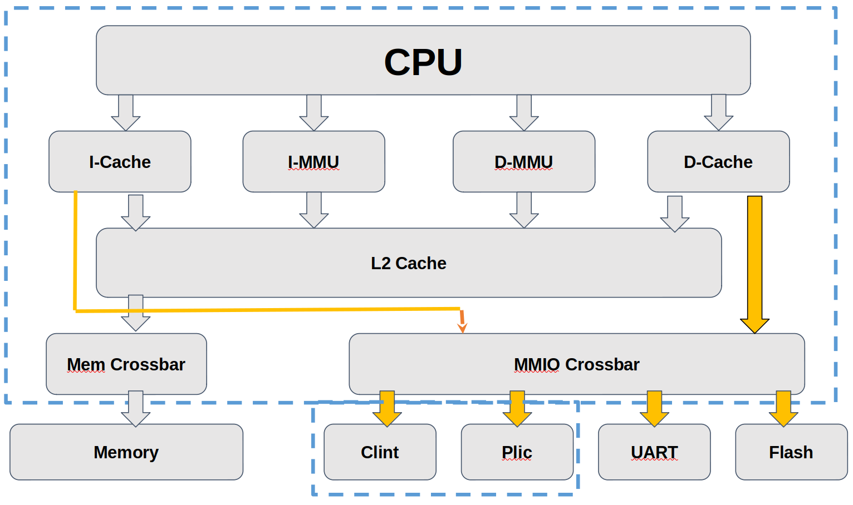
ZJV 1.0 技术指标——微结构设计
What is more? Your own CPU.
48

Slide 49
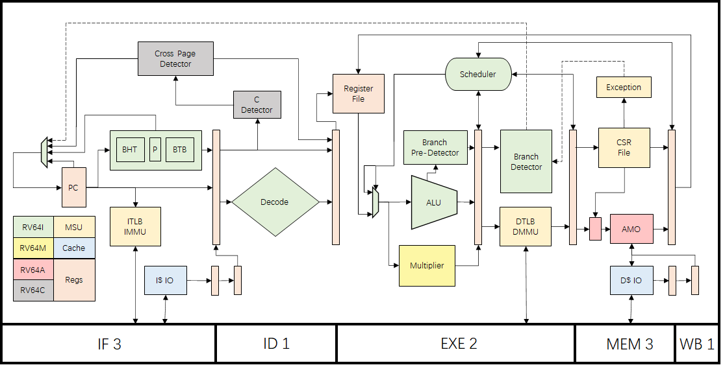
What is more? Your own CPU.
ZJV 1.0 技术指标——微结构设计
49

Slide 50
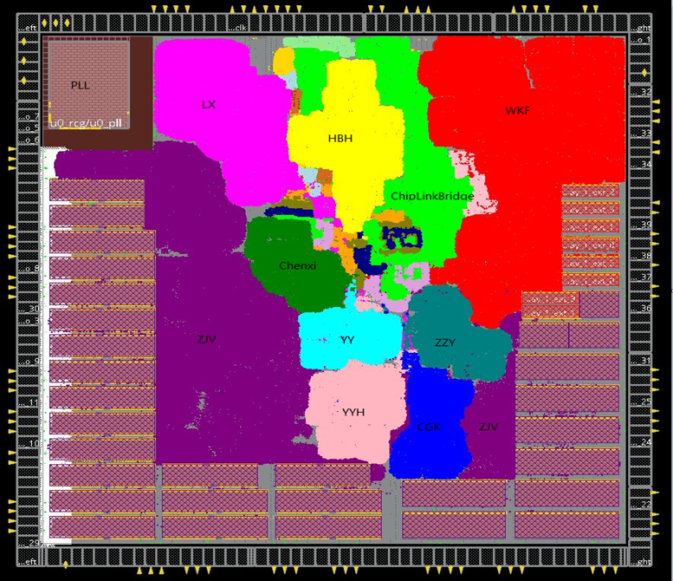
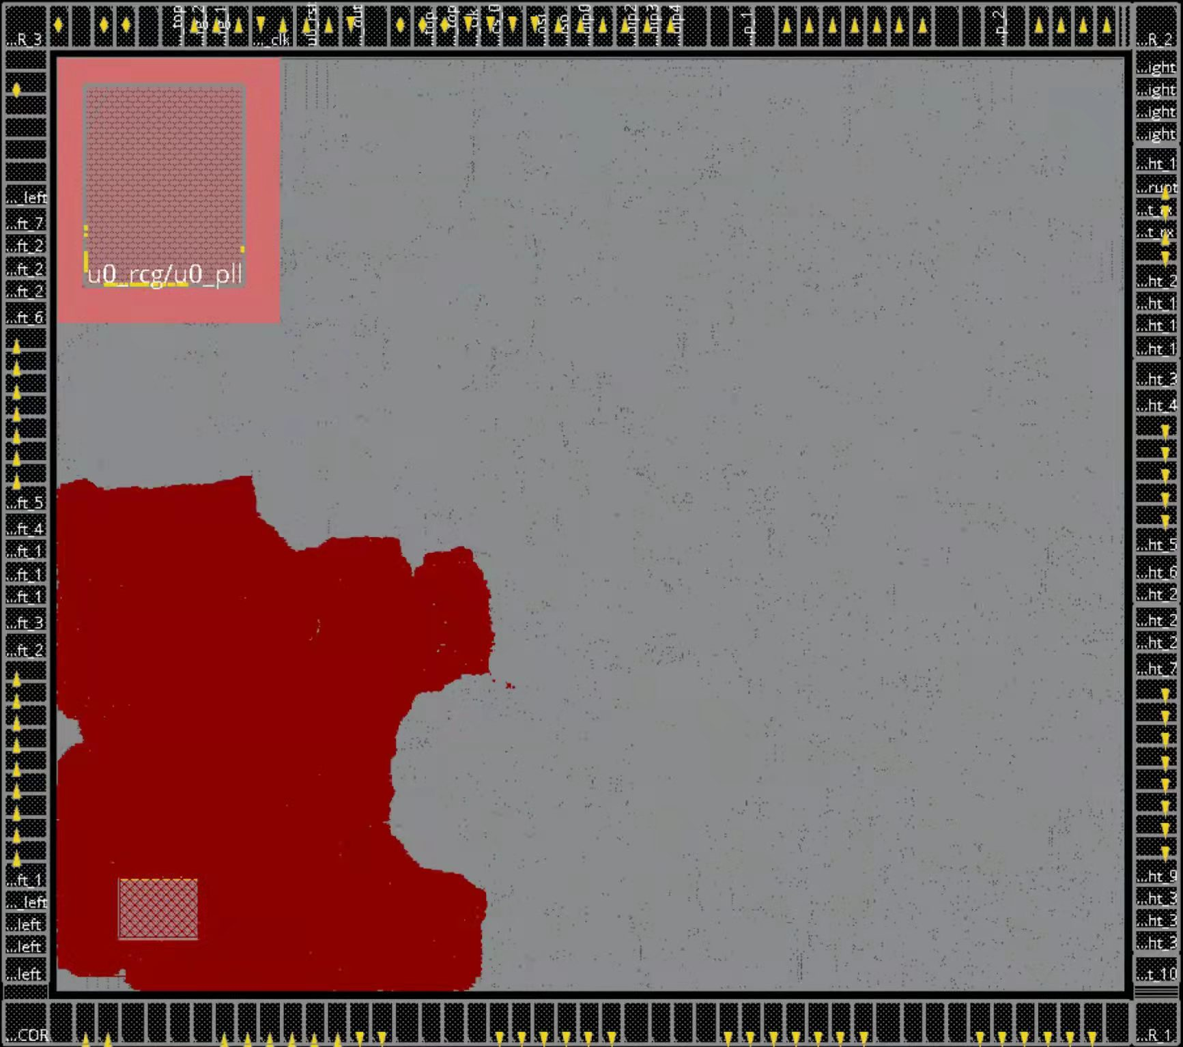
ZJV1.0——流片成果（一生一芯二期）
50

Slide 51
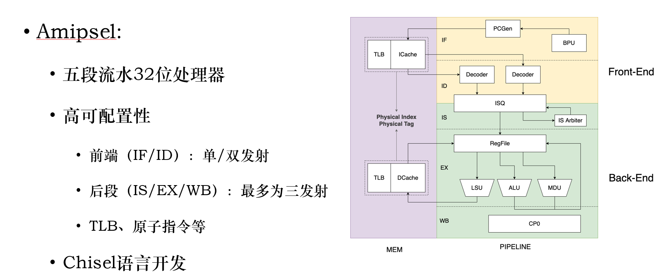
What is more? Your own CPU.
51

Slide 52
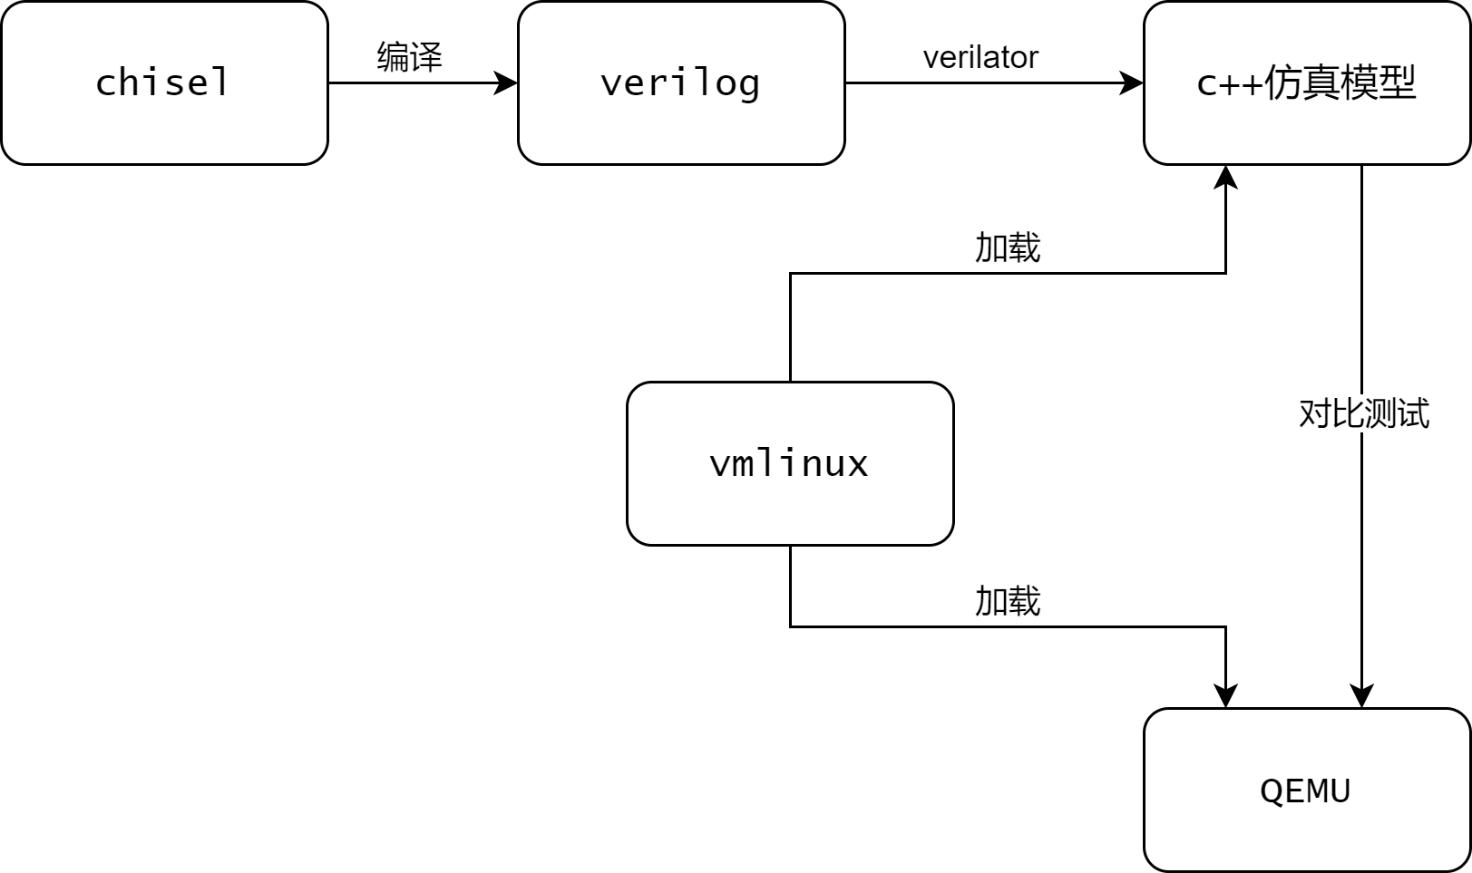
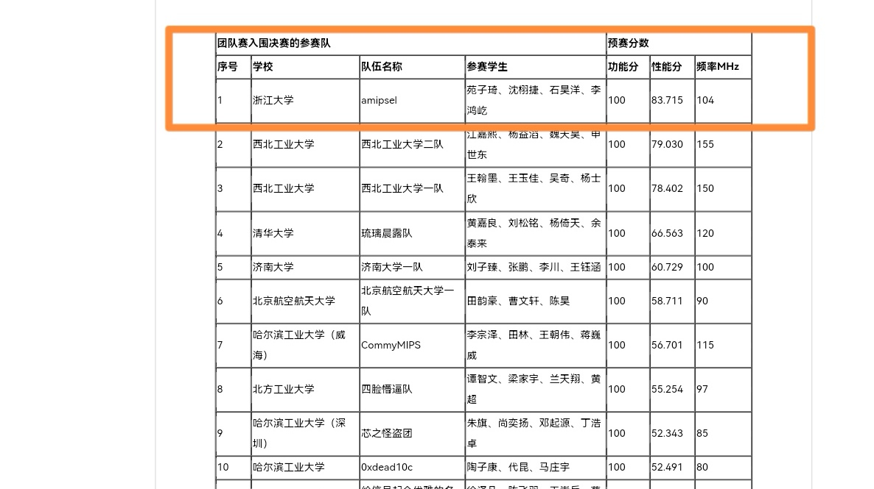
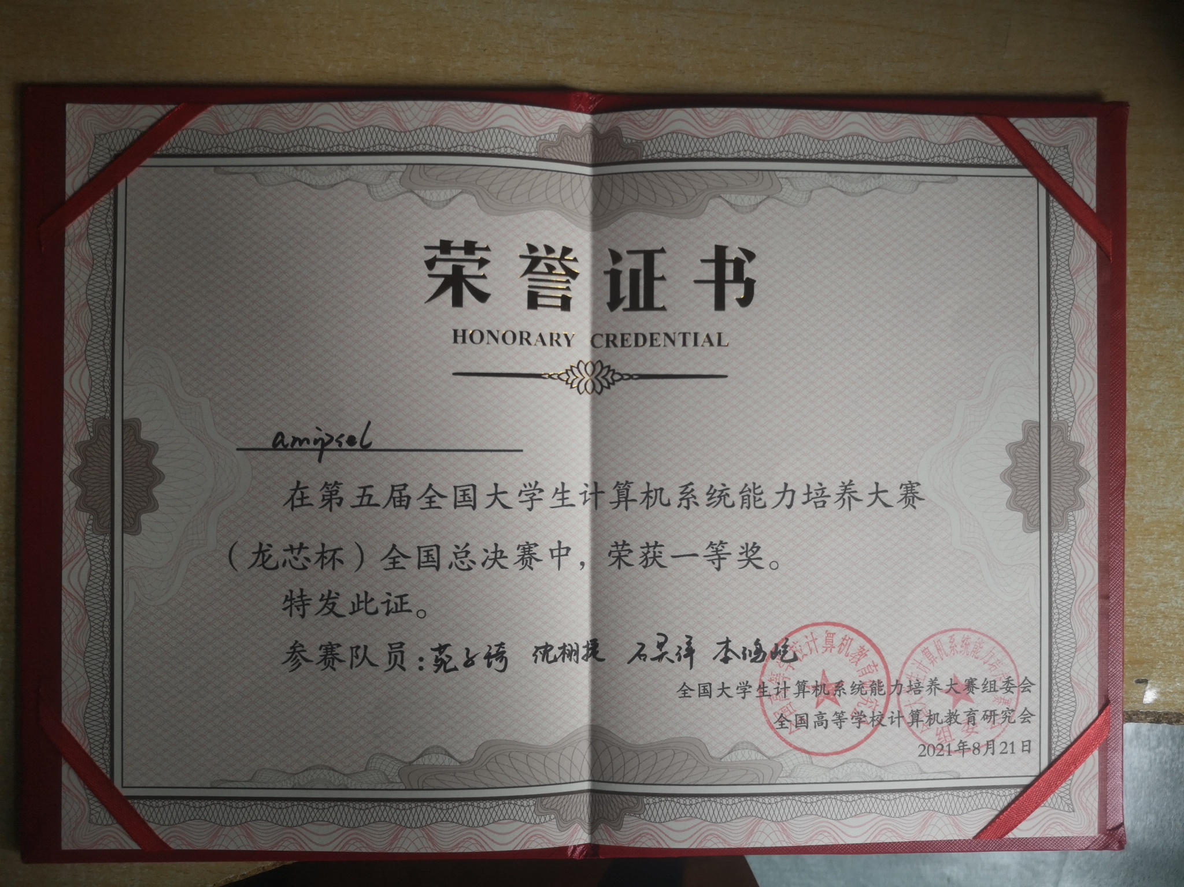
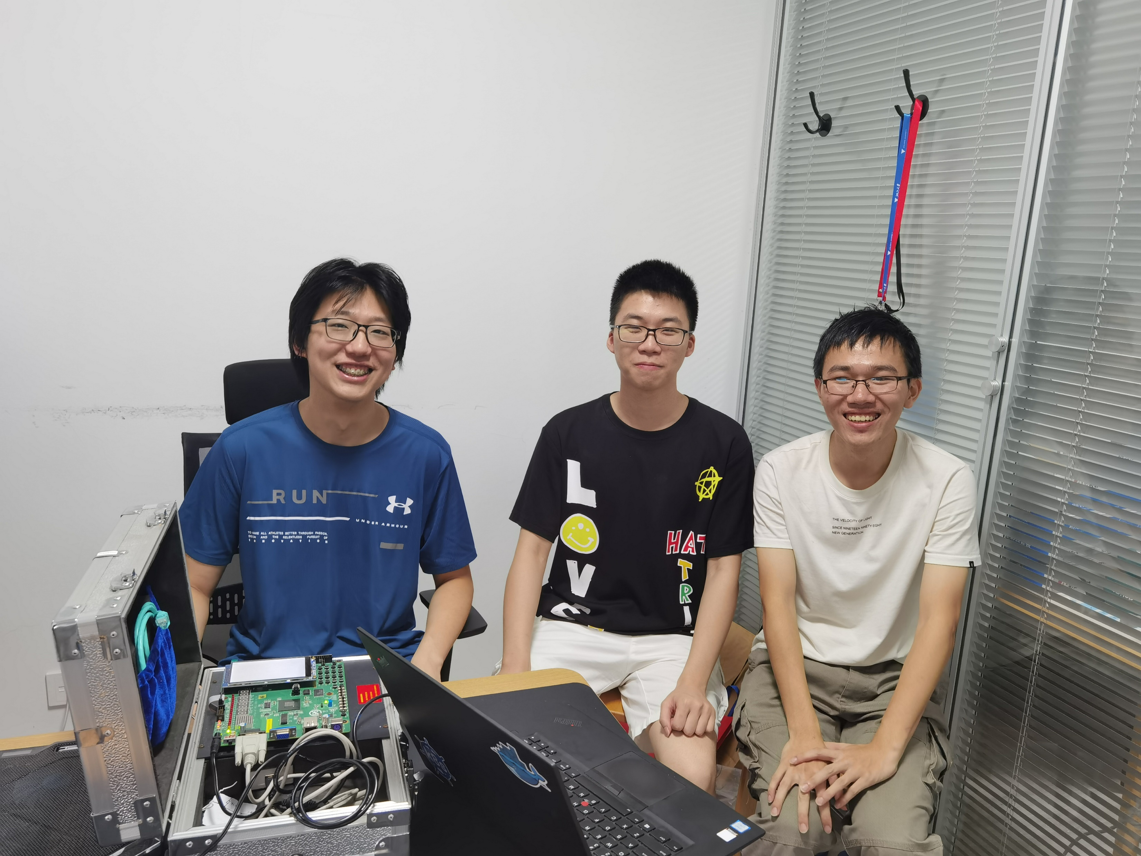
What is more? Your own CPU.
自主搭建的差分测试框架dtqemu
模拟RAM和串口等外设
同步中断
比对qemu和AMipsel的寄存器
便捷Linux的调试
操作系统移植
支持pmon的全部指令运行
支持ucore的运行
完成Linux的启动流程到用户态
52

Slide 53
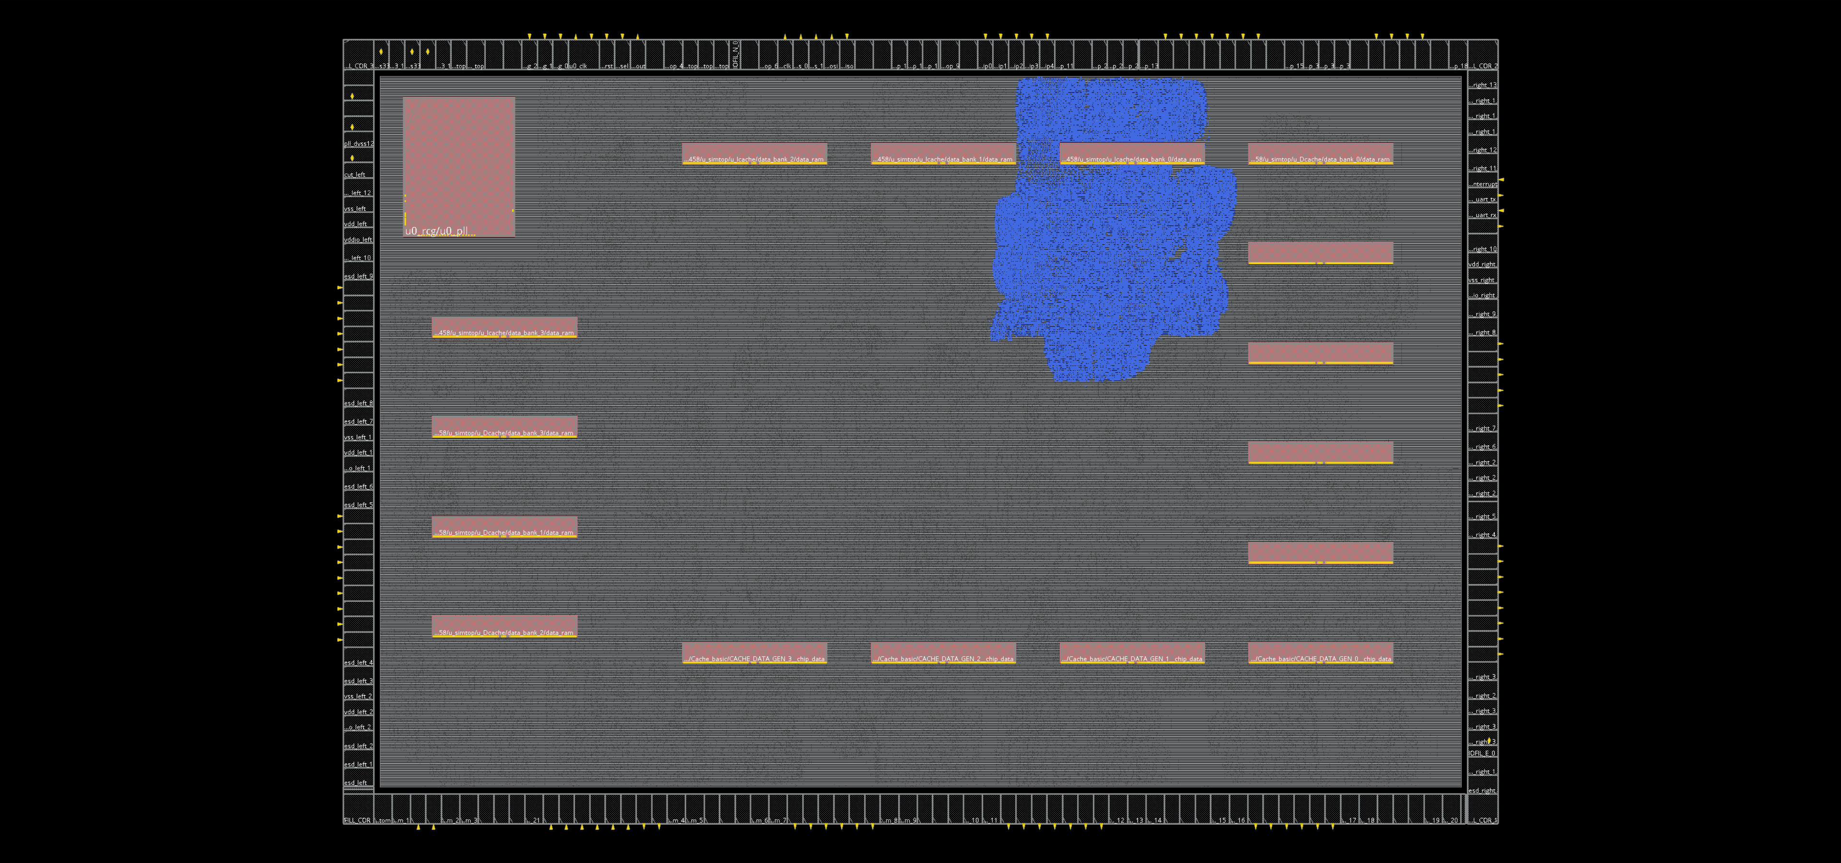
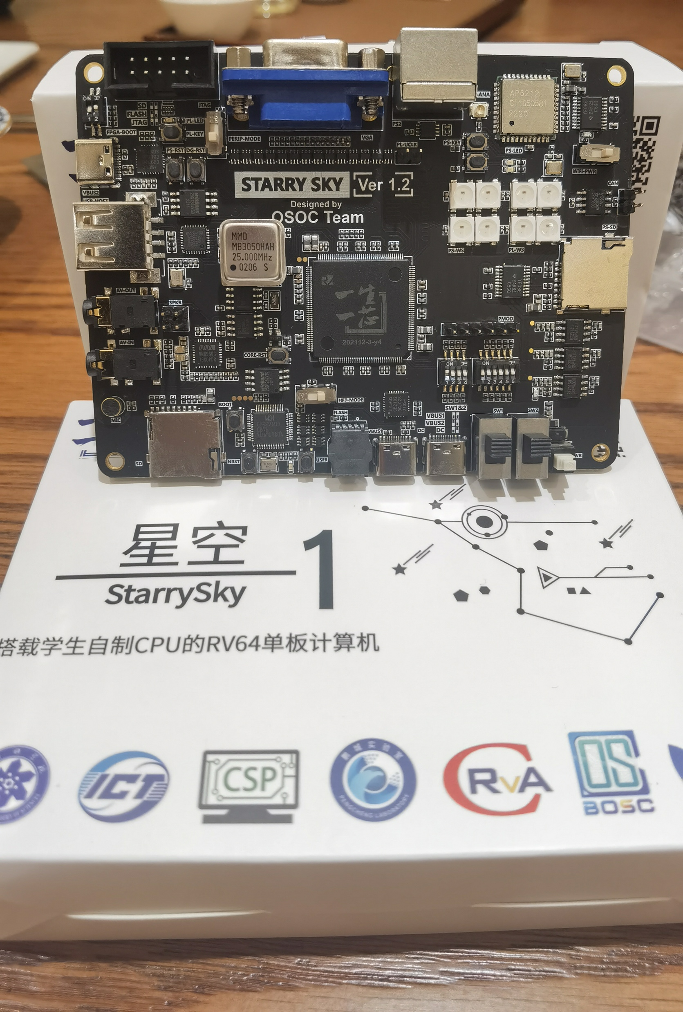
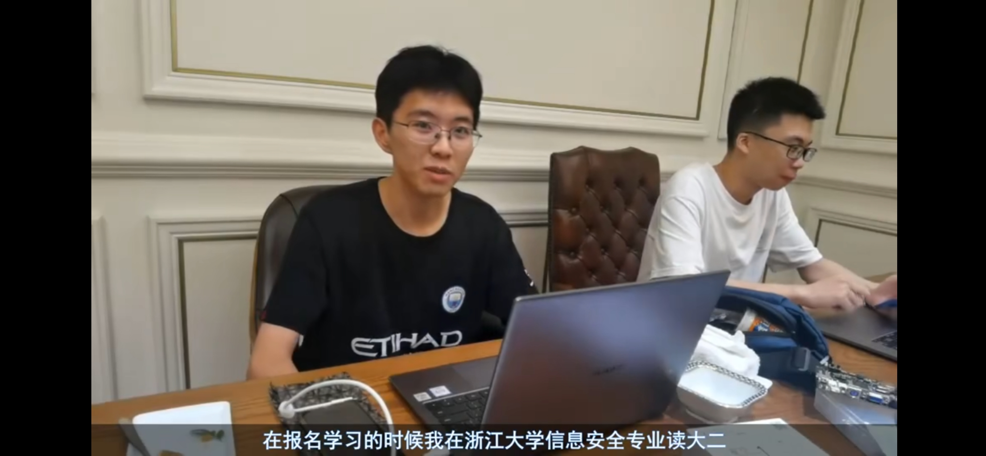
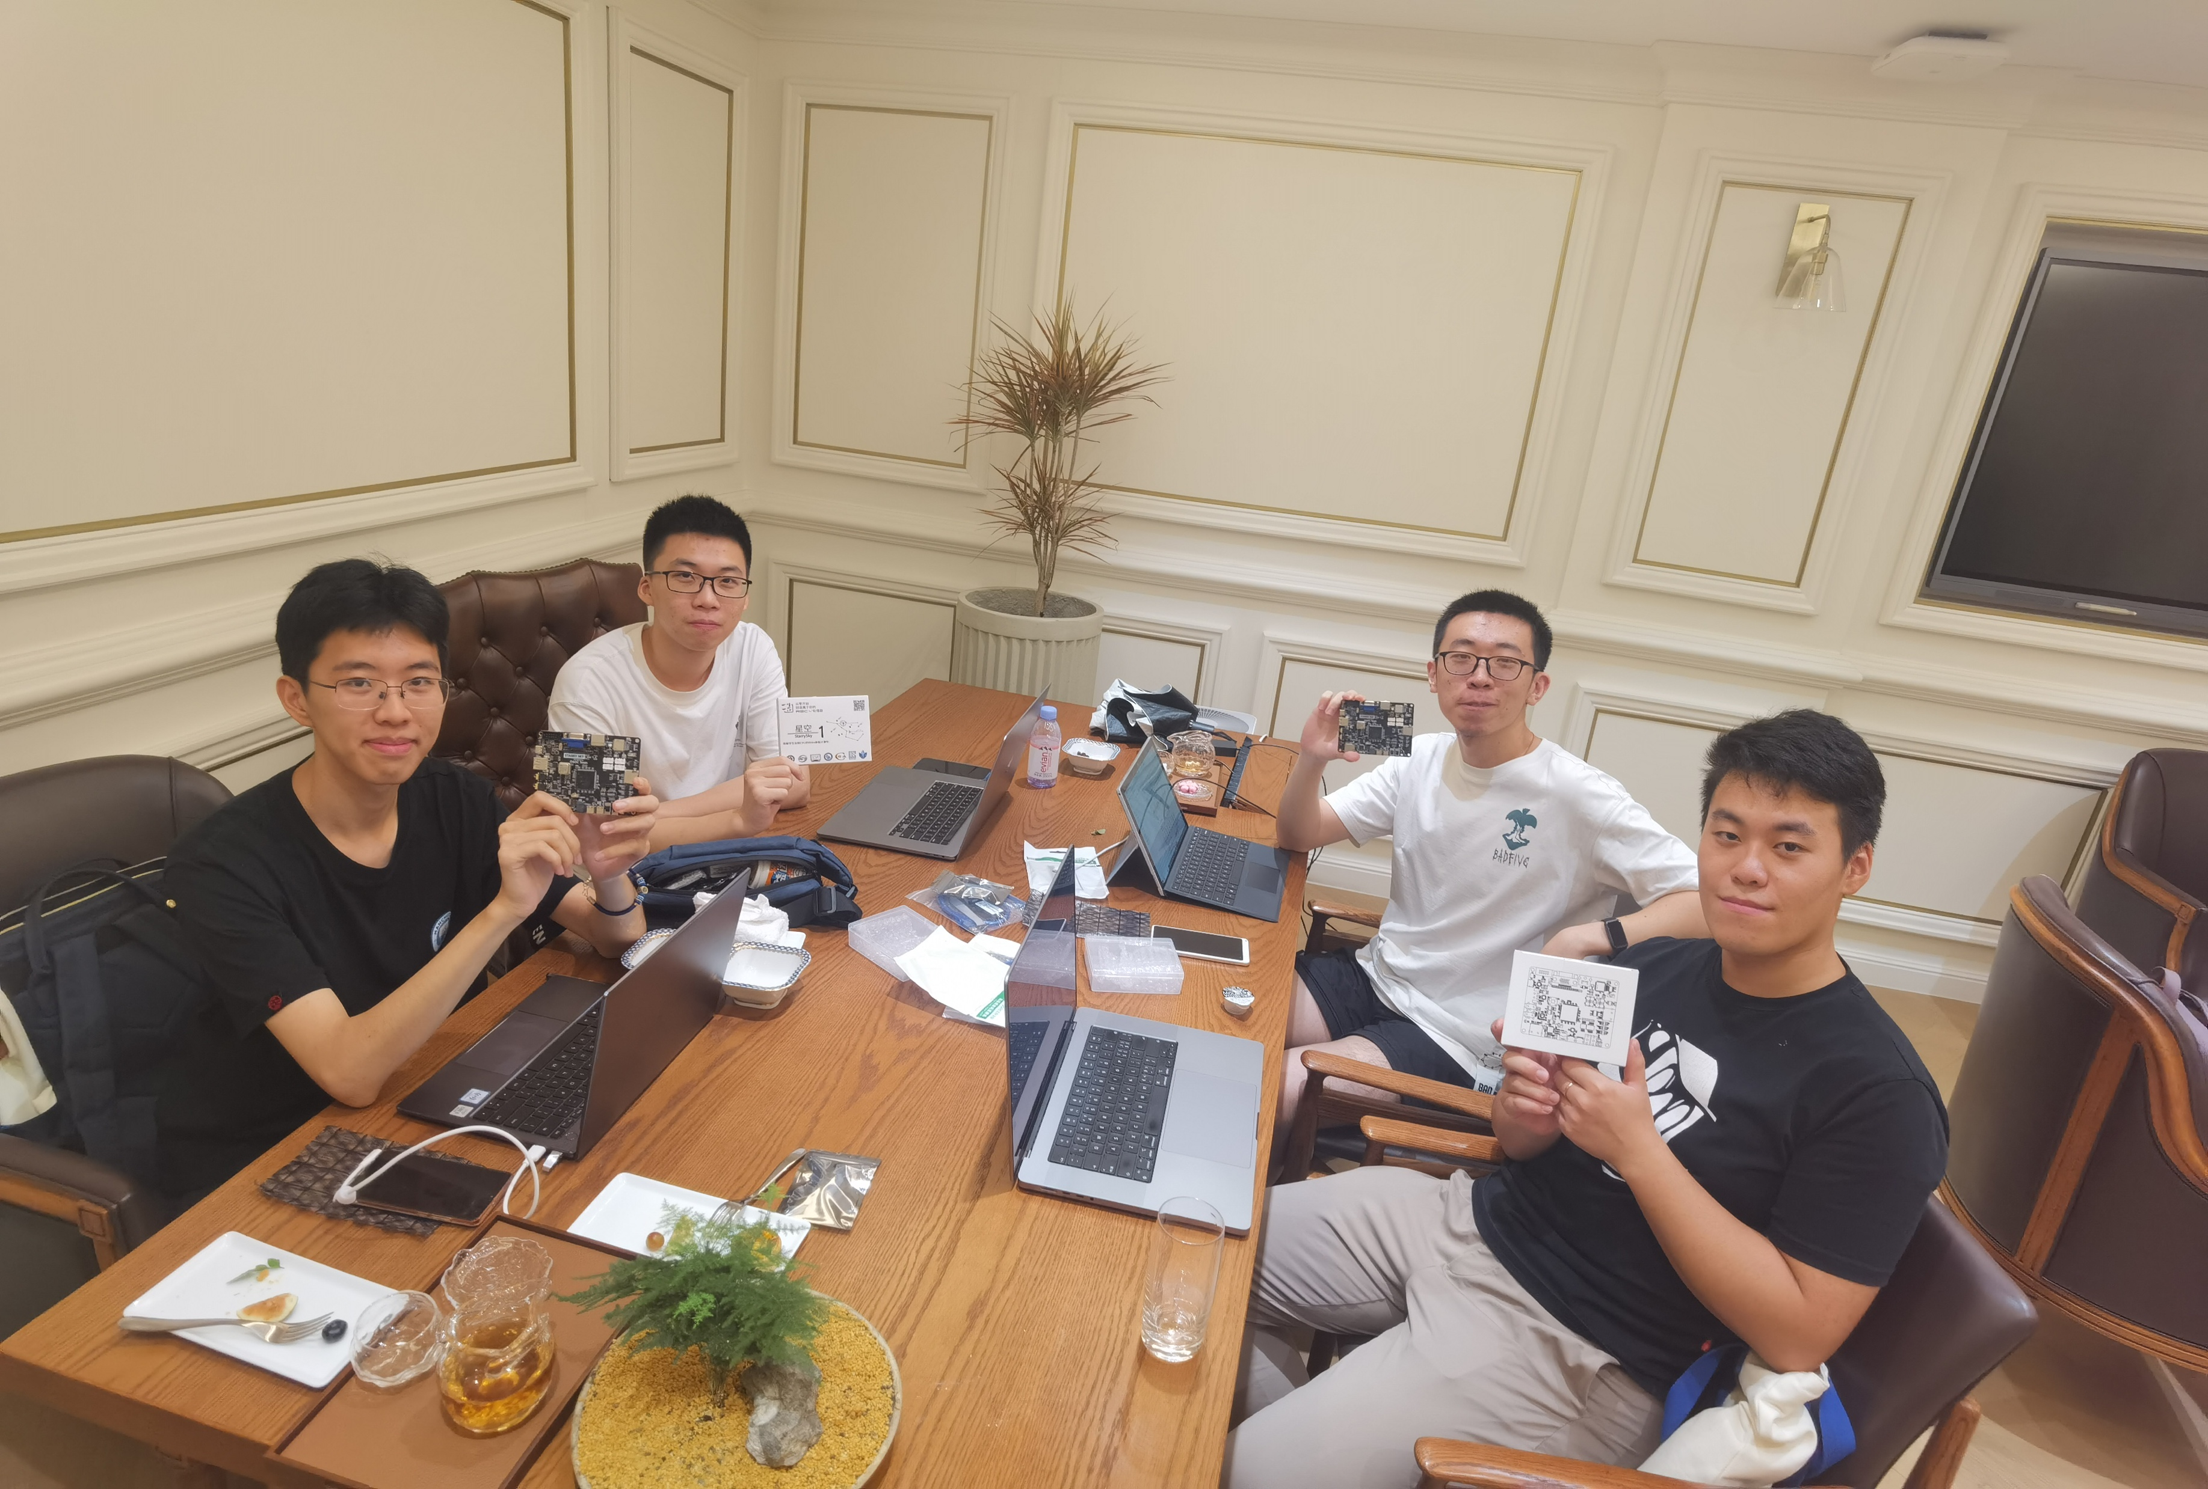
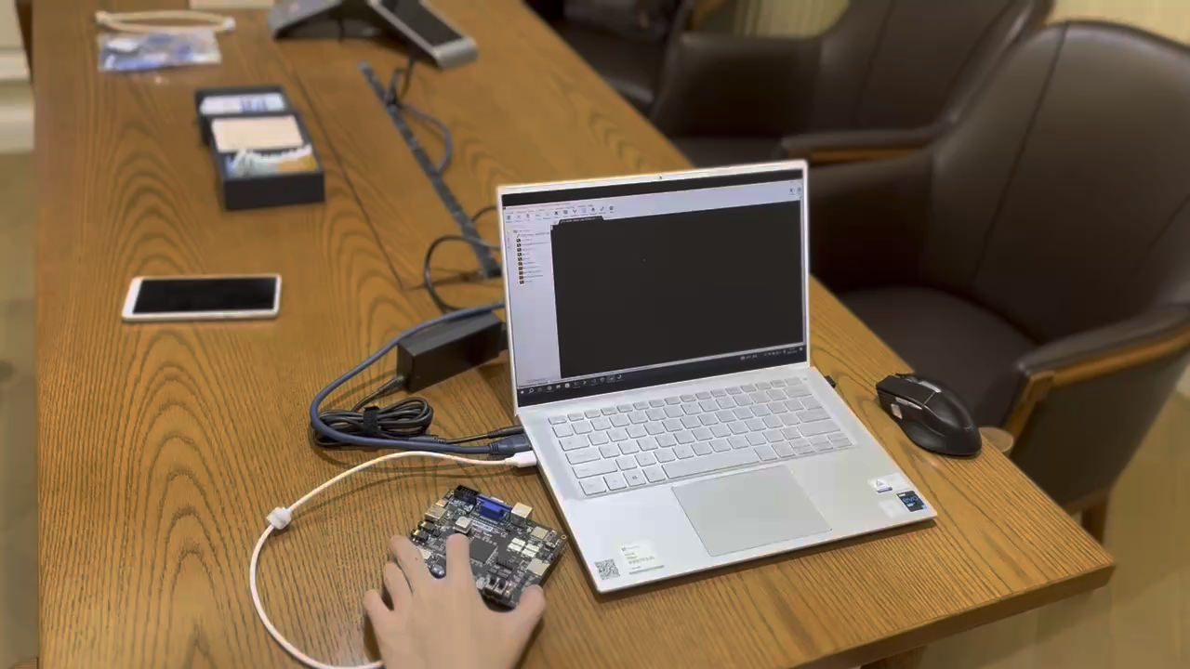
ZJV2.0 ——流片成果（一生一芯三期）
53

Slide 54
What is more? Your own CPU + system.
逐梦杯总决赛：
自主设计优化，获得1789性能分
面向通用系统，启动Linux 发行版
着眼安全特性，保护数据完整性和机密性
54

Slide 55
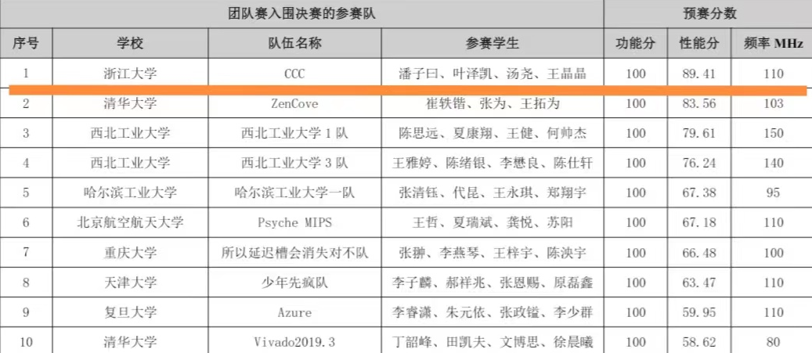
What is more? Your own CPU + system.

Slide 56
What is more? Our idea (not only CPU)
ZJV = ZheJiang University + RISC-V
ZJV 1.0
ZJV 2.0
Amipsel
ZJV 2.0
plus
MMM
2020.12
第一次投片
2021.08
龙芯杯一等奖
（性能第一名）
2021.12
ZJV 2.0投片
ZJV 1.0第二次投片
待续
2022
逐梦杯
冠军
2022.08
龙芯杯二等奖
（性能第一名）

Slide 57
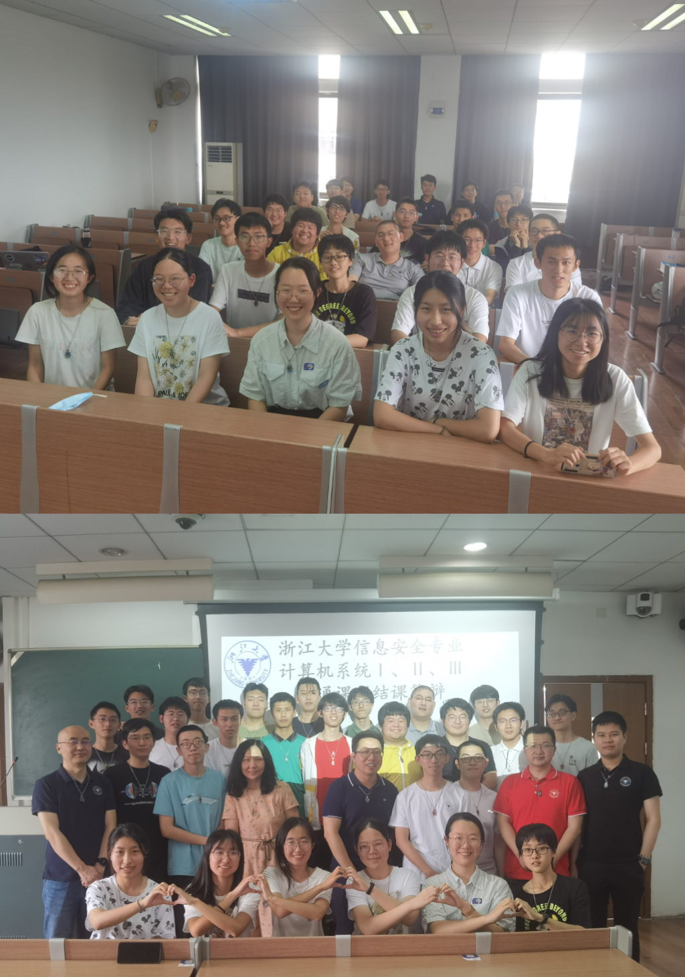
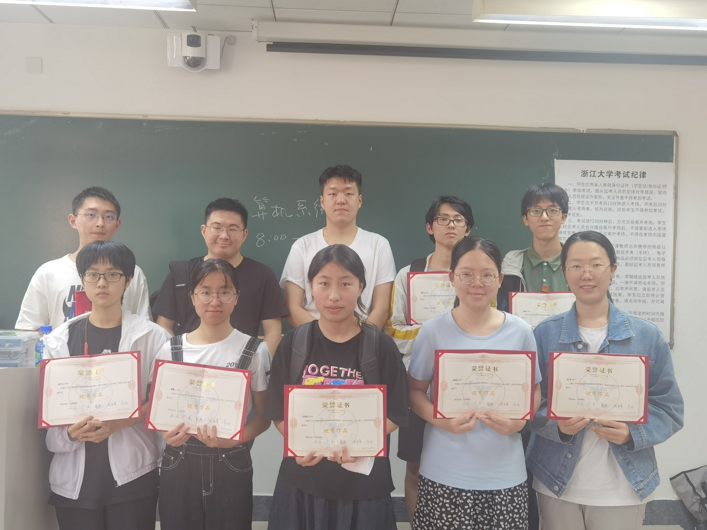
浙江大学信息安全专业
第一届计算机系统贯通课程

Slide 58
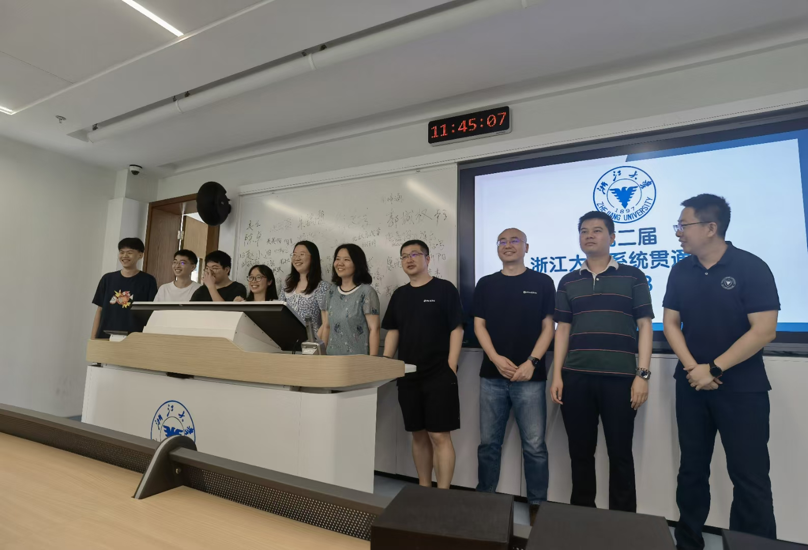
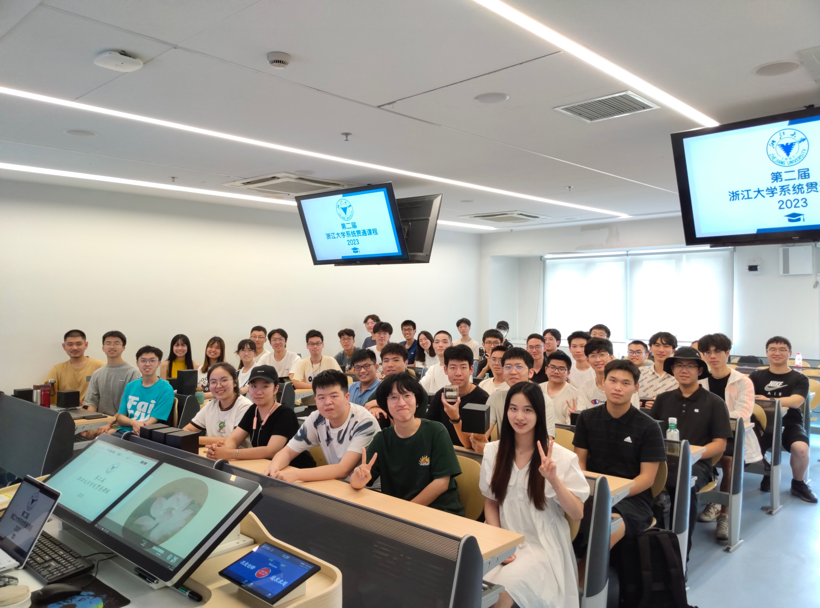
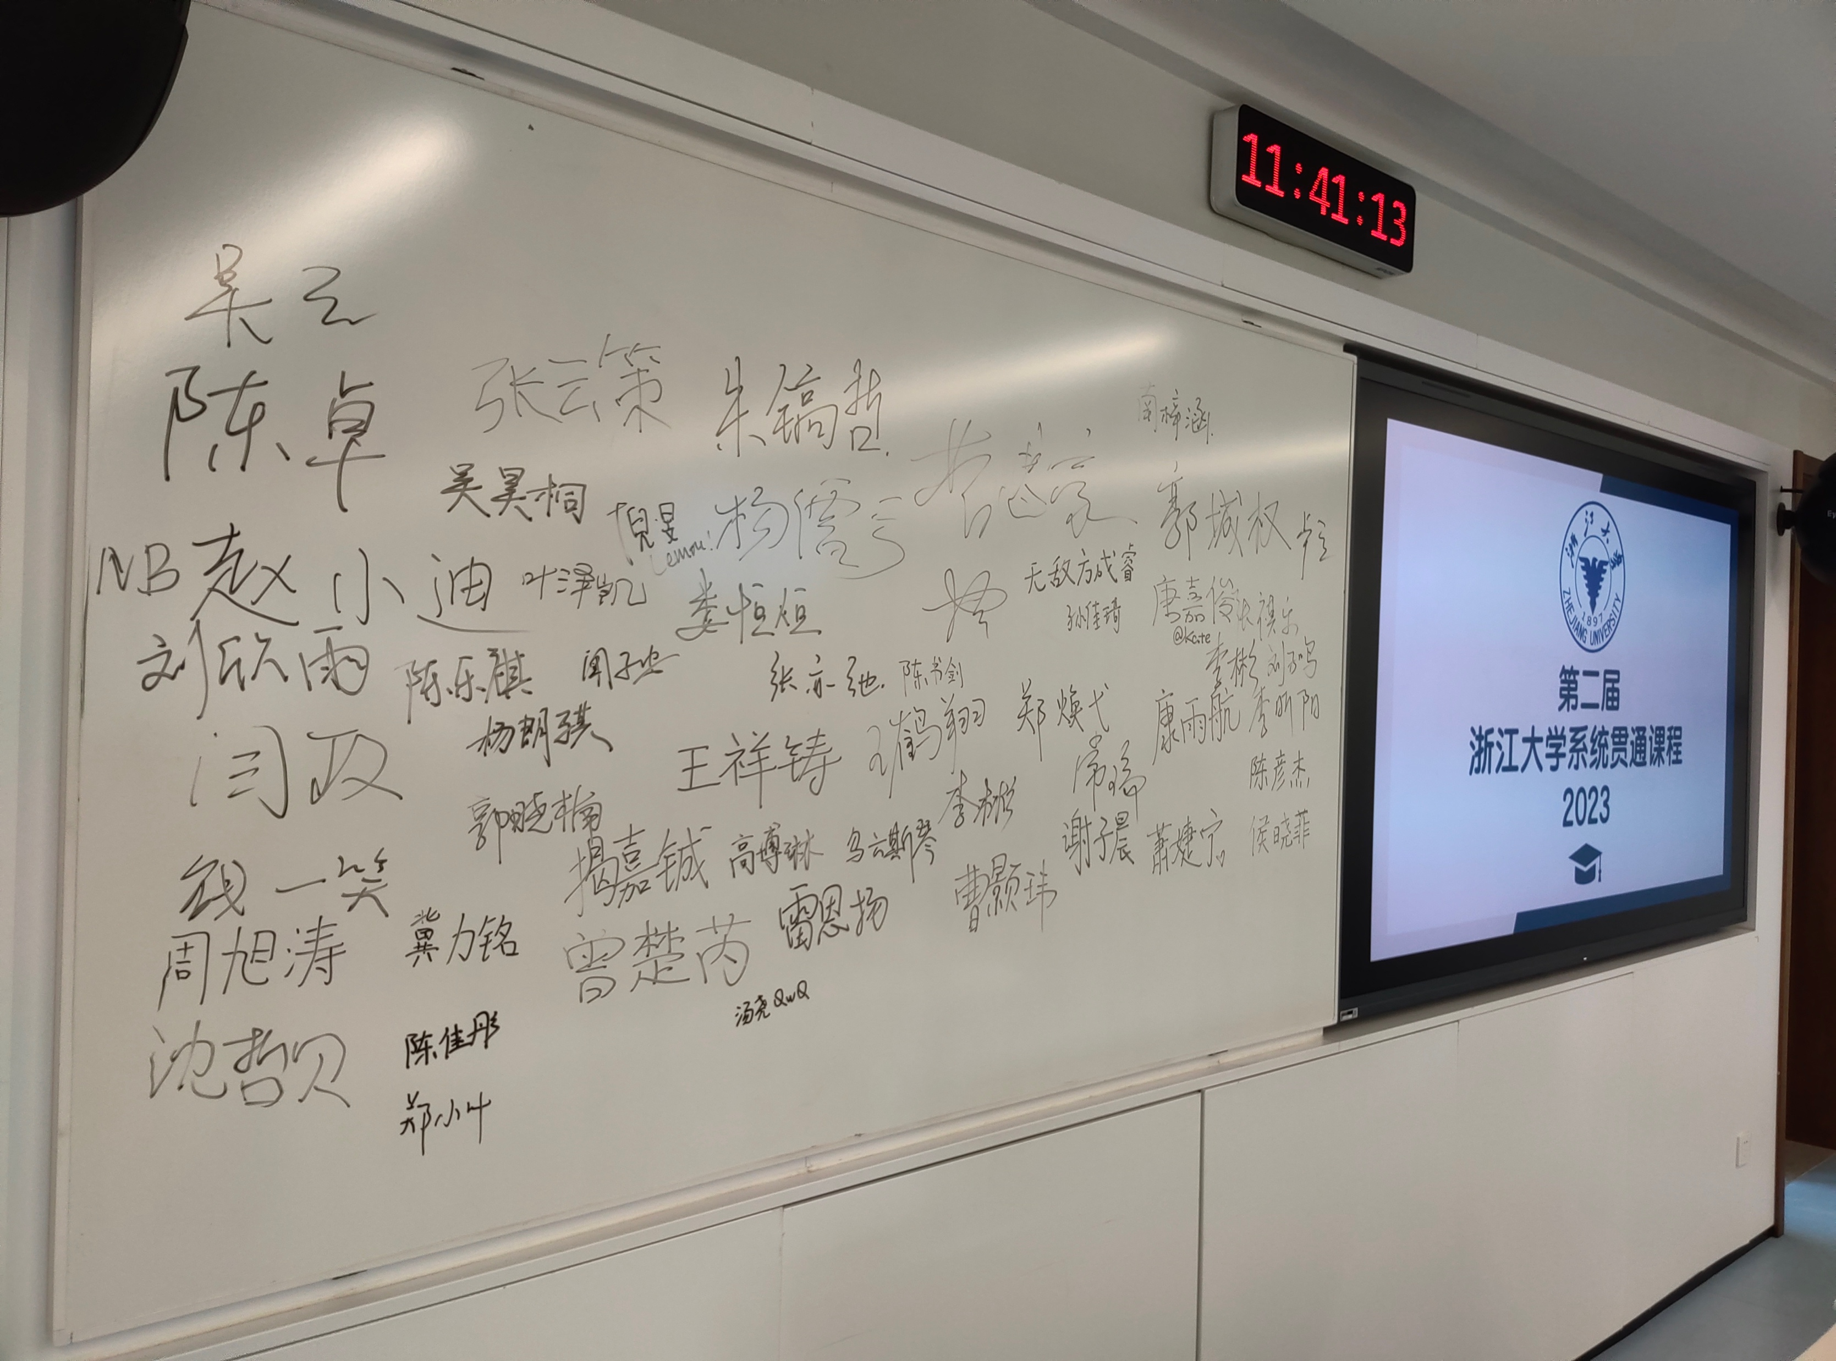
浙江大学信息安全专业
第二届计算机系统贯通课程

Slide 59
Today’s Agenda
Why take system courses?
About system courses
Course overview
Evolution of computer systems

Slide 60
Course Objective
Understand the HW / SW interface
How a processor works
How a computer is organized
Establish a foundation for building applications
How to write a good program
Good = correct, fast, and secure
How to understand where the world is going
Understand technology (past, present, future)

Slide 61
Course Topics
Information Representation ~ 2 weeks
Foundations of Digital Logic ~ 1 week
Combinational Logic Circuit ~ 1 week
Sequential Logic Circuit ~ 2 week
Computational Operations & Units ~ 1 week
Assembly Language ~ 1 weeks
Instruction Set Architecture (ISA) ~ 2 weeks
Single-Cycle CPU Design ~ 6 weeks

Slide 62
Don’t Worry, Just A Small Target……
Program counter
register
current instruction
register
register
Memory
ALU
Control
Unit
I/O
System

Slide 63
Prerequisites
Courses
C Programming Language - required
Assembly Language - optional
Skills
Basic programming experience
The more, the better

Slide 64
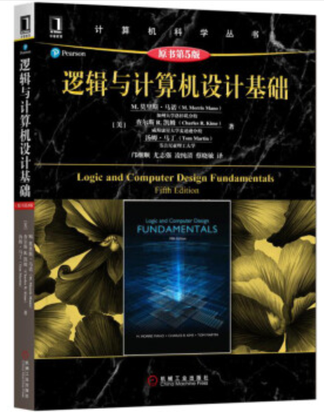

Course Material
Lecture Notes
Will be posted
Textbook
Logic and Computer Design Fundamentals
Fifth Edition
References
《数字逻辑与计算机组成》
编者：袁春风、武港山、吴海军、余子濠
Computer Organization and Design
RISC-V Edition 1st Edition

Slide 65
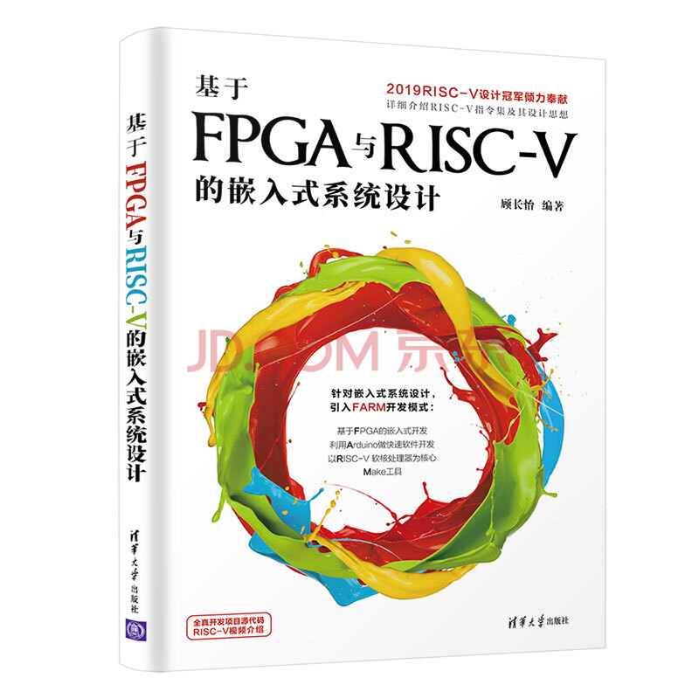
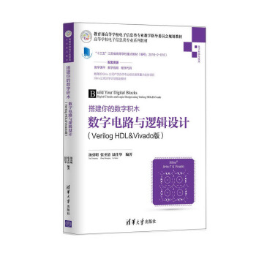
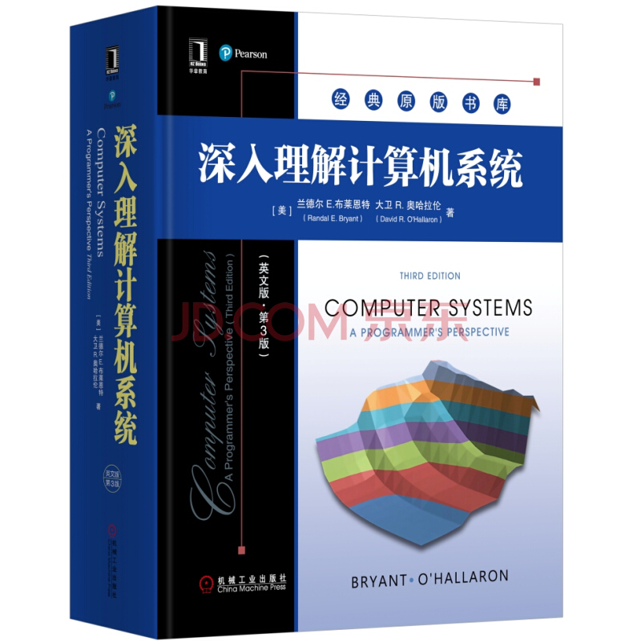
Some Other References (Optional)

Slide 66


C Resources (Optional)

Slide 67
Course Organization
Lectures
Monday (ZJG East 1A-214)
7-8 (14:15 – 15:50 )
Wednesday (ZJG East 1A-214)
7-8 (14:15 – 15:50 )
Labs
Thursday (ZJG East 4-509)
6-8 (13:25 AM – 15:50 AM)
No group, please work alone

Slide 68

Class Grading

Slide 69
A Look into AMD CPU

Slide 70




LUT

Slide 71



LUT

Slide 72
Course Policies
Academic integrity
We will strictly enforce the university, college, and department policies against academic dishonesty
Plagiarism in any form will not be tolerated!
Unless otherwise noted, work turned in should reflect your independent capabilities
If unsure, note / cite sources and help
Late penalized: homework 5%/day，project 25%/week
No penalty for documented emergency or by prior arrangement in special circumstances

Slide 73
Today’s Agenda
Why take system courses?
About system courses
Course overview
Evolution of computer systems

Slide 74

Evolution of Computer Systems

Slide 75


Slide 76

Primal Ancient

Slide 77


Ancient
Turing Machine
1936
Alan Turing
= abstract model for CPU that can simulate any algorithm
Notes:
How does The Imitation Game, Engima/Bombe, Turing relate to you and this course?!
Alan Turing thesis in 1936 came up with an abstract model for a CPU that can simulate any algorithm, a Turing Machine. You will build a CPU and understand it and its organization
http://en.wikipedia.org/wiki/Turing_machine
A Turing machine is a hypothetical device that manipulates symbols on a strip of tape according to a table of rules. Despite its simplicity, a Turing machine can be adapted to simulate the logic of any computer algorithm, and is particularly useful in explaining the functions of a CPU inside a computer.
Note that every part of the machine (i.e. its state, symbol-collections, and used tape at any given time) and its actions (such as printing, erasing and tape motion) is finite, discrete and distinguishable; it is the unlimited amount of tape and runtime that gives it an unbounded amount of storage space.

Slide 78


In the Ancient Days…
The Bombe
used by the Allies to
break the German
Enigma machine during
World War II
Enigma machine
Used by the Germans during
World War II to encrypt and
exchange secret messages
Notes:
http://en.wikipedia.org/wiki/Bombe
How many possible combinations to break an Enigma cipher text (msg encrypted by the Enigma machine)?
Rotors x Rotor posititions x plugboard combinations with 10 pairs = 159 quintillion = 1.59 x 10^20 158,962,555,217,826,360,000
Rotors (3 of 5 rotors): 5 x 4 x 3 = 60
Rotor positions: 26 x 26 x 26 = 17,526
plugboard: 26! / (6!10!2^10)
Numberphile on Enigma/Bombe
For those who want to learn more about the mechanism of the Bombe and how it exploited the flaw in the Enigma, Numberphile has recently done an excellent episode on it. Enjoy!
Flaw in the Enigma: http://www.youtube.com/watch?v=V4V2bpZlqx8
Previous episode on Enigma: http://www.youtube.com/watch?v=G2_Q9FoD-oQ

Slide 79

First Generation
ENIAC Electronic Numerical Integrator And Computer
1946
John Mauchly
J. Presper Eckert

Slide 80



Second Generation
IBM 7090 Human Computers programming the IBM 7090
Mary Jackson
Hidden Figures

Slide 81

Generations of Computer Systems

Slide 82

Vacuum Tube -> Transistor

Slide 83

Where did it begin?
Electrical Switch
On/Off
Binary
Transistor
The first transistor on a workbench at AT&T Bell Labs in 1947

Slide 84

Then and Now
https://en.wikipedia.org/wiki/Transistor_count
https://www.computershopper.com/computex-2015/performance-preview-desktop-broadwell-at-computex-2015
The first transistor
One workbench at AT&T Bell Labs
1947
Bardeen, Brattain, and Shockley
Intel Broadwell
7.2 billion transistors, 14nm
456 square millimeters
Up to 22 processing cores
https://en.wikipedia.org/wiki/Transistor_count

Slide 85
Moore’s Law
1965
# of transistors integrated on a die doubles every 18-24 months (i.e., grows exponentially with time)
Amazingly visionary
2300 transistors, 1 MHz clock (Intel 4004) - 1971
16 Million transistors (Ultra Sparc III)
42 Million transistors, 2 GHz clock (Intel Xeon) – 2001
55 Million transistors, 3 GHz, 130nm technology, 250mm2 die (Intel Pentium 4) – 2004
290+ Million transistors, 3 GHz (Intel Core 2 Duo) – 2007
721 Million transistors, 2 GHz (Nehalem) - 2009
1.4 Billion transistors, 3.4 GHz Intel Haswell (Quad core) – 2013
7.2 Billion transistors, 3-3.9 GHz Intel Broadwell (22-core) – 2016
…

Slide 86


Slide 87
Thanks!

